Slide 1
ANTIRETROVIRAL THERAPY
Pharmacology of drugs

Slide 2
HIV-1 Life cycle
gp41
gp120
Viral
assembly
HOST CELL
Translation
Protein
RNA and
cleavage
Glycosylation
reverse
NNRTIs & NRTI work here
transcriptase
Budding
Reverse
Protease
transcription
Transcription
Injection
of capsid
contents
PIs work here
Fusion inhibitors work here
RNA
DNA
Provirus
Integrase
(circular
Maturation
structure)
Integration of provirus
DNA into host DNA
Binding
HIV particle
Binding
sites
Completed
Cell
HIV particle
membrane

Slide 3
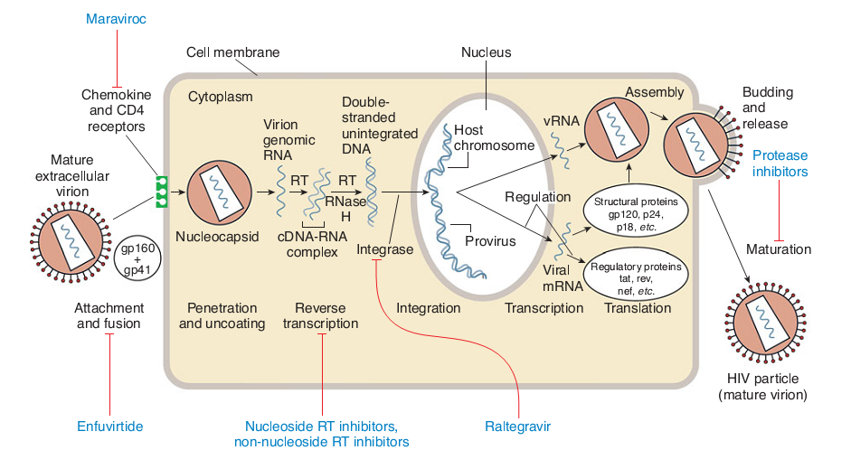

Slide 4
Classification of ARVs
Fusion/entry inhibitors
Reverse transcriptase inhibitors
Nucleoside and Nucleotide Reverse Transcriptase Inhibitors (NRTIs; ‘nukes’)
Non-Nucleoside Reverse Transcriptase Inhibitors (NNRTIs; ‘non-nukes’)
Integrase inhibitors
Protease Inhibitors
Assembly/budding inhibitors

Slide 5
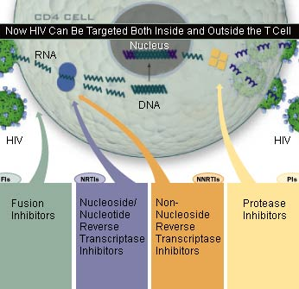

Slide 6
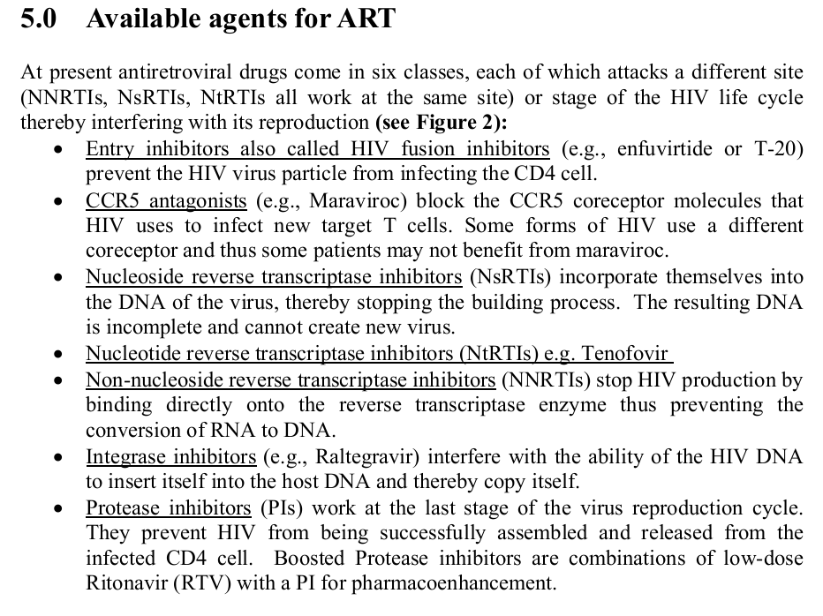

Slide 7
Nomenclature of ARVS
Generic Name Developmental Relative
[Trade Name] (other names) antiviral
effect
Nucleoside Reverse Transcriptase Inhibitors (NsRTI) or [Nucleoside analogues] {‘nukes”}
Zidovudine [Retrovir]* AZT; azidothymidine ++
Didanosine [Videx] ddI; dideoxyinosine ++
Stavudine [Zerit] D4T ++
Zalcitabine [Hivid] ddC; didoxycytidine +
Lamivudine [Epivir] 3TC ++
Abacavir [Ziagen] 152U89 +++
Emtricitabine FTC +++
Nucleotide Reverse Transcriptase Inhibitors (NtRTI)
Tenofovir TDF +++
Non-Nucleoside Reverse Transcritase Inhibitors (NNRTI) or [Non-Nucleoside analogues] or ‘non-nukes’
Nevirapine [Viramune] BI-RG-587 +++
Efavirenz [Sustiva] DMP266 +++
Delavirdine [Rescriptor] U-90152S/T +++

Slide 8
Nomenclature of ARVS
Generic Name Developmental Relative
[Trade Name] (other names) antiviral
effect
Protease Inhibitors
Saquinavir
soft gel [Fortovase] ++
hard gel [Invirase] Ro-31-8958 +++
Indinavir [Crixivan] MK-639 +++
Ritonavir [Norvir] ABT-538 +++
Nelfinavir [Viracept] AG-1343 +++
Lopinavir_{R} [Kaletra] ABT-378 +++
Atazanavir BMS-232632 +++
Fosamprenavir VX-175 +++
Fusion Inhibitor
Enfuvirtide (Fuzeon) T-20

Slide 9
Evolution of Antiretrovirals
Between ’87 and ’95, 4 antiretrovials were launched.
Since ’95, 19 new products have been introduced.
Combivir
Tenofovir
DDC
3TC
Delarvidine
AZT
Nevirapine
Abacavir
FTC
DDI
D4T
Efavirenz
Trizivir
’87
’88
’89
’90
’91
’92
’93
’94
’95
’96
’97
’98
’99
‘00
’01
‘02
‘03
‘04
Saquinavir
Nelfinavir
Kaletra
Atazanavir
Fortovase
Amprinavir
NRTI
Fuzeon (T20)
Ritonavir
NNRTI
Fosaprenavir
Indinavir
PI
Notes:
Up until 1995, there were only 4 drugs approved for the treatment of HIV infection. Since that time, 12 new drugs have entered the marke, with introductions of new classes of agents that interfere with different viral targets.
Today,combination therapy that uses several drugs with complementary mechanisms of action have produced the most effective means of controlling HIV replication, thereby slowing disease progression.

Slide 12
Entry inhibitors
Enfurvitide (ENF;T-20) (Fuzeon)
Maraviroc (MVC)(Selzentry)
Experimental: Vicriviroc, Ibalizumab

Slide 13
Enfurvitide (ENF;T-20) (Fuzeon)
This drug is a small peptide of the following sequence: Acetyl-YTSLIHSLIEESQNQ QEKNEQELLELDKWASLWNWF-amide
Blocks entry of HIV into cells by blocking the fusion of the HIV envelope to the cell membrane, hence preventing infection of the CD4 cell; HIV-1

Slide 14
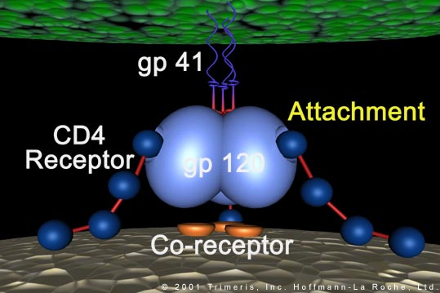

Slide 15
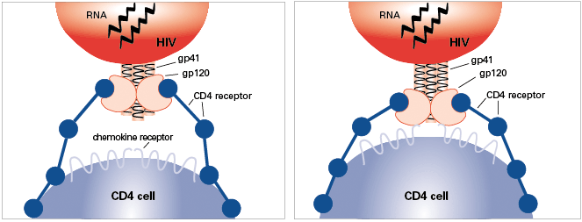
Notes:
There are several key proteins involved in the HIV entry process:
CD4, a protein receptor found on the surface of Helper T cells in the human immune system, also called CD4+ T cells
gp120, a protein on HIV surface that binds to the CD4 receptor
CCR5, a second receptor found on the surface of CD4+ cells, called a chemokine coreceptor
CXCR4, another chemokine coreceptor found on CD4+ cells
gp41, a HIV protein, closely associated with gp120, that penetrates the cell membrane

Slide 16
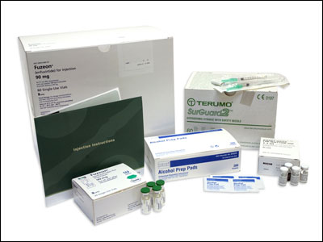
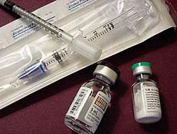
By virtue of its peptide nature, enfuvirtide is marketed in injectable form. The lyophilised enfuvirtide powder must be reconstituted by the patient and administered twice daily by subcutaneous injection
Dose: 90 mg s.c bd
Patients experience painful injection site reaction

Slide 17
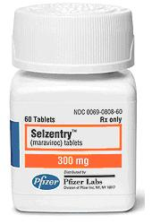
Maraviroc (MVC)(Selzentry)
Blocks the CCR5 co-receptor, hence blocking viral entry
Active against CCR5-tropic virus (of HIV 1), which predominates in early part of infection
Dose: 150-300 mg bd
150mg BID with P450 inhibitors
600mg BID with P450 inducers
SE: cough, fever, rash, problems, abdominal pain, dizziness
Notes:
Maraviroc is an entry inhibitor.
Specifically, maraviroc blocks the chemokine receptor CCR5 which HIV uses as a coreceptor to bind and enter a human helper T cell.
Because HIV can also use another coreceptor, CXCR4, an HIV tropism test such as a trofile assay must be performed to determine if the drug will be effective.

Slide 18
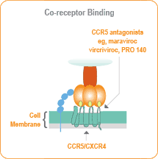
Chemokine Receptor Antagonists
CCR5 or CXCR4 receptors on cell surface
Virus will bind to one of the 2 receptors
Some patients’ virus will bind to either receptor
Marviroc blocks viral entry at CCR5

Slide 19
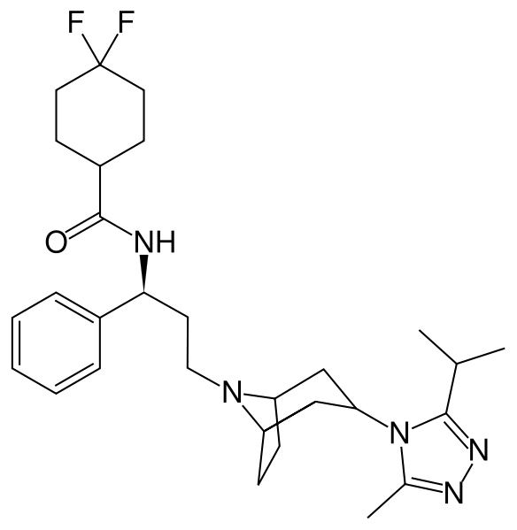
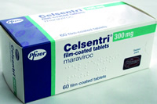
Maraviroc
Approved in April, 2007 and marketed by Pfizer

Slide 20
Nucleoside and Nucleotide Reverse Transcriptase inhibitors (NRTIs)

Slide 21
Mode of action: NRT & NNRTIs
HIV RNA
Reverse transcriptase Inhibitors
PROVIRAL DNA
(incorporated into host cell chromosome)
NsRTI & NtRTI
Contain “false” nucleotides/ (sides) used by RT
Active against HIV-1 and HIV-2
Resistance occurs due to mutations at pol gene
NNRTIs
Antagonist to RT
Active against only HIV-1
Resistance occurs much rapidly due to mutations in pol gene

Slide 22
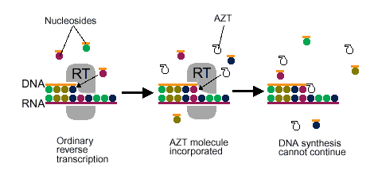
NRTIs Mechanism of Action
Nucleoside analogs (like AZT below)
Analog of thymidine, cytosine, adenine, or guanine ) but lack the 3’-hydroxy group.
Triphosphorylated inside lymphocytes to active compound
Incorporate into the growing HIV viral DNA strand by reverse transcriptase
Nucleotide analog
Currently only tenofovir (TDF)
Does NOT need to be tri-phosphorylated only di-phosphorylated to active compound
After incorporation of
the NRTI, viral DNA
synthesis will be
terminated.
Notes:
Are nucleoside analogues (A,G,C,T), but lacking a –OH gp on their ribose molecule
They block replication of the viral genome by competitively inhibiting incorporation of native nucleotides and by terminating elongation of the developing proviral DNA
They act as alternative substrates or false building blocks, differing from the actual molecules by a minor modification in the ribose molecule.

Slide 23
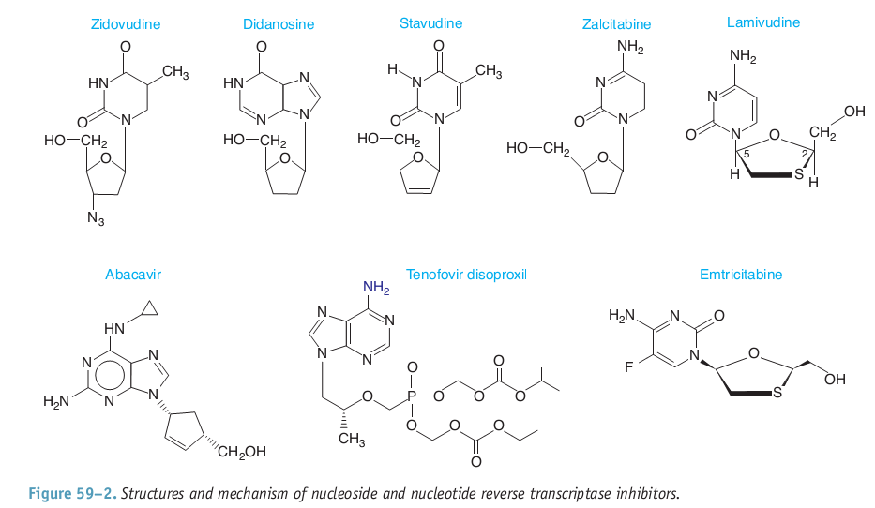
Notes:
Certain HIV drugs in the nucleoside reverse transcriptase inhibitor (NRTI) class sometimes have negative side effects that may lead to liver problems. One such side effect is damage to the mitochondria inside your cells, or mitochondrial toxicity. When mitochondria are damaged, lactic acid is not broken down. This can cause levels of lactic acid in your blood to rise. If the levels of lactic acid become too high, a rare, but serious condition called lactic acidosis can occur.

Slide 24
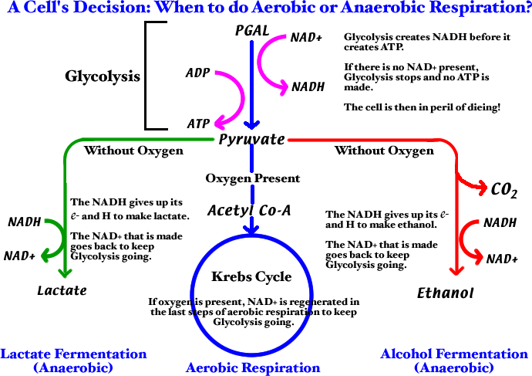
NRTI Class Toxicities
Lactic Acidosis
Damage to mitochondria in cells
Elevated lactate, low pH/bicarbonate, N/V, shortness of breath, if untreated can lead to death
Hepatomegaly with Steatosis
Build up of fat droplets
inside liver cells
Enlarged liver
Notes:
Are selective inhibitors of viral enzyme, but can also inhibit human DNA polymerase Gamma, a mitochondrial enzyme
This is responsible for the toxicities due to in part inhibition of mitochondrial DNA synthesis
SE: anemia, peripheral neuropathy, pancreatitis, lactic acidosis
Key Points
When mitochondria are damaged, lactic acid is not broken down
Lactic acidosis is a condition caused by the buildup of lactic acid in the blood.
Early signs of lactic acidosis can include fatigue, loss of appetite, nausea and vomiting, stomach pain, and weight loss.
Signs of life-threatening lactic acidosis can include above-normal heart rate, rapid breathing, jaundice (yellowing of the skin and the whites of the eyes), and muscle weakness.
Treatment for lactic acidosis involves stopping the HIV medicine that is causing the condition. In the rare cases when lactic acidosis becomes life-threatening, immediate treatment in a hospital is necessary.

Slide 25
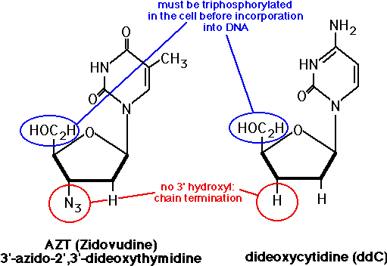
Mechanism of action of AZT

Slide 26
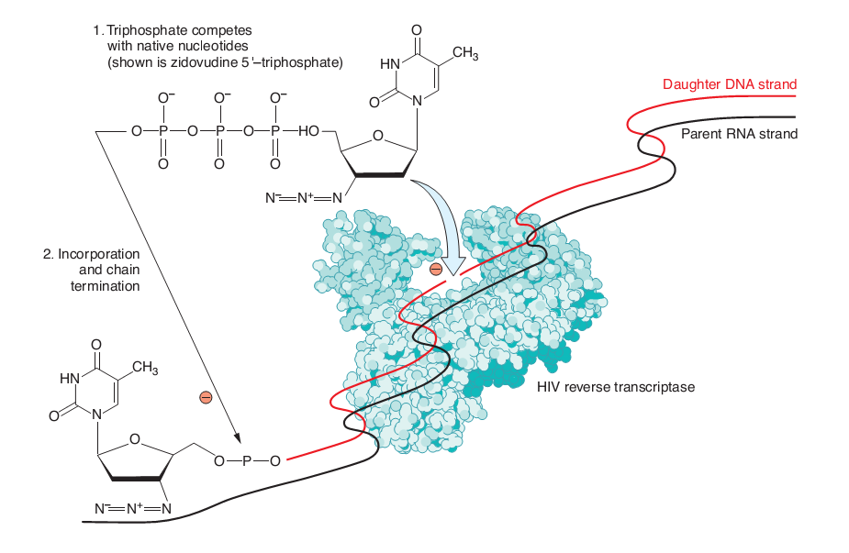

Slide 27
Thymidine analogues
Zidovudine (AZT, Retrovir) – 300 mg bd;
SE: anaemia, neutropenia; and lipodystrophy (long term use)
Can cause bone marrow suppression hence should not be used in patients with pre-existing anaemia, granulocytopenia, and taking other bone marrow suppressive drugs
Stavudine (d4T, Zerit) – 30 mg bd;
SE: Lypodystrophy, peripheral neuropathy; and lactic acidosis and hepatitis (prolonged use)
NB: These two agents should never be given in the same combination

Slide 28
Cytidine analogues
Lamivudine (3TC, Epivir); 150 mg bd or 300 mg od
Emtricitabine (FTC, Emtriva); 200 mg od
NB: 1. These two don’t have significant side effects
2. They have activity against Hepatitis B
Zalcitabine (ddC, Hivid); 0.75 mg tid;
SE: Peripheral neuropathy, and rarely pancreatitis
Should avoid co-administration with either stavudine or didanosine

Slide 29
Adenosine analogues
Didanosine (ddI, Videx); 400mg od, (250mg od for <60 kg);
SE: pancreatitis, painful peripheral neuropathy, May cause neutropenia
NB: Should not be given with Stavudine and Zalcitabine
Guanosine analogues
Abacavir (ABC, Ziagen); 300 mg bd;
SE: Hypersensitivity

Slide 30
Nucleotide analogues
Tenofovir (Adenosine 5-monophosphate derivative) (TDF, Viread); 300 mg od;
Well tolerated
Active against HBV
Used in caution in people with pre-existing renal disease

Slide 31
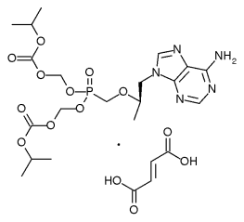
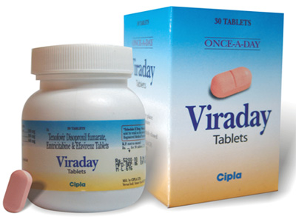
Nucleotide Reverse Transcriptase Inhibitor
Tenofovir disoproxil fumarate

Slide 32
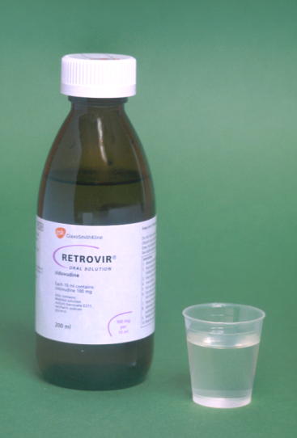
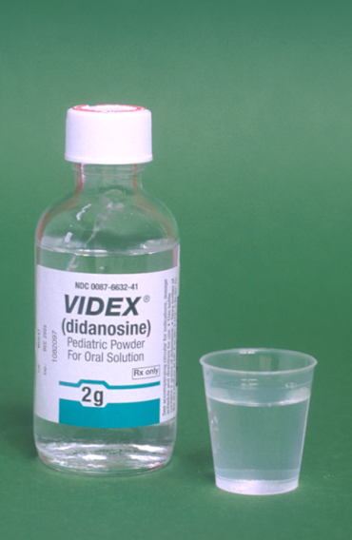
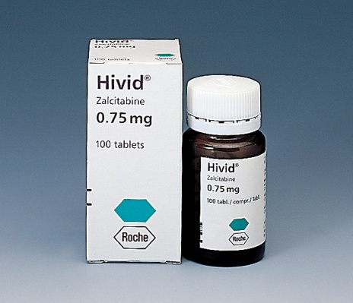
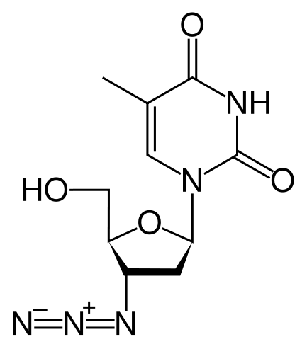
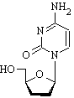
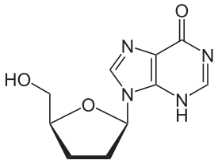
Nucleoside Reverse Transcriptase Inhibitors (NRTI’s)
didanosine/Videx, Videx EC (ddI)
zalcitabine/HIVID (ddC)
Zidovudine/Retrovir
(AZT, ZDV)

Slide 33
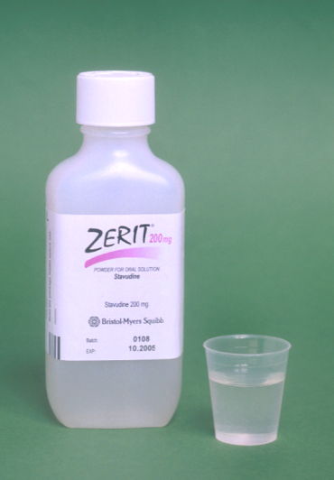
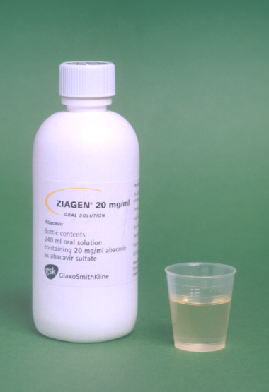
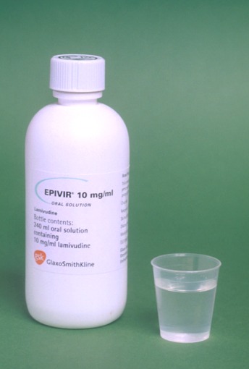
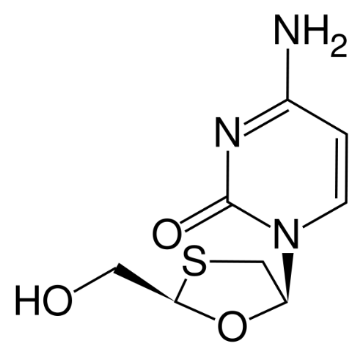
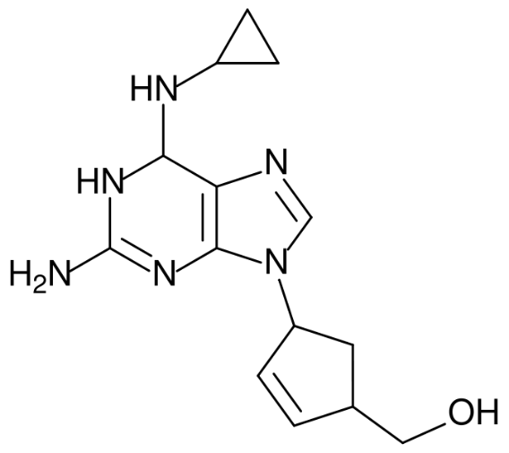
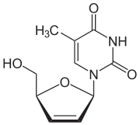
Nucleoside Reverse Transcriptase Inhibitors (NRTI’s)
Stavudine/Zerit (d4T)
Lamivudine/Epivir
(3TC)
Abacavir/Ziagen (ABC)

Slide 34
NRTIs
Drug | Standard Dose* | Dosage forms | Common Side Effects | Metabolism/ Elimination
Zidovudine (ZDV/AZT) Retrovir | 300mg bid* | 300mg tab, 100mg cap, iv, oral soln | Fatigue, malaise, HA myalgia, anemia, GI | Renal
Lamivudine (3TC) Epivir | 150mg bid* or 300mg qd | 150, 300mg tab, oral soln | Well tolerated | Renal
Emtricitabine (FTC) Emtriva | 200mg qd* | 200mg cap | Well tolerated | Renal
Didanosine (ddI) Videx | 400mg EC qd (≥ 60kg) 250mg EC qd (<60kg)* | 125,200,250, 400mg cap, pwdr for soln | Pancreatitis, peripheral neuropathy, LA/HS | Renal

Slide 35
NRTIs
Drug | Standard Dose* | Dosage forms | Common Side Effects | Metabolism/ Elimination
Stavudine (d4T) Zerit IR | 40mg bid (≥ 60kg) 30mg bid (<60kg) * | 15,20,30,40 mg cap,oral soln | Peripheral neuropathy, Pancreatitis, LA/HS, Lipoatrophy, facial wasting | Renal
Abacavir (ABC) Ziagen | 300mg bid, 600mg qd | 300mg tabs, oral soln | hypersensitivity | Hepatic by alcohol dehydrogenase and glucuronyl transferase
Tenofovir (TDF) Viread | 300mg qd* | 300mg tabs | Few SEs, renal toxicity | Renal
*dose reduce for renal dysfunction

Slide 36
NRTI Combinations
Drug | Standard Dose* | Dosage forms
Lamivudine/ Zidovudine (COM) Combivir | 1 Tablet bid * | 150/300mg tabs
Abacavir/Lamivudine/Zidovudine (TZV) Trizivir | 1 Tablet bid* | 300/150/300mg tabs
Tenofovir/Emtricitabine Truvada | 1 Tablet qd* | 300/200mg tabs
Abacavir/Lamivudine Epzicom | 1 Tablet qd* | 600/300mg tabs
Tenofovir/Emtricitabine/Efavirenz Atripla | 1 Tablet qd* | 300/200/600 mg tabs
*dose reduce for renal dysfunction

Slide 37
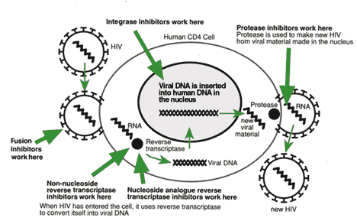
Non-nucleoside Reverse Transcriptase Inhibitors (NNRTIs)
X
Notes:
Like the Nucleoside Inhibitors, NNRTIs (also known as non-nucleosides) stop HIV from replicating within cells by inhibiting the reverse transcriptase protein.
NNRTI’s are generally hydrophobic molecules that bind to an allosteric binding site
Binding to this allosteric site locks the neighboring substrate-binding site into an inactive conformation.
However, resistance to NNRTI’s can develop rapidly, and thus they are used in combination with NRTI’s

Slide 38
Non-Nucleoside Reverse Transcriptase Inhibitors
Attach on the allosteric site of the reverse transcriptase enzyme
Hence act as non-competitive inhibitors
Don’t require intracellular phosphorylation to attain activity
Efavirenz
Nevirapine
Delavirdine
Are metabollized by cytochrome system (CYP3A4 and CYP2B6). Hence can be inducers of these enzymes (NVP, EFV) or inhibitors (DLV)
Hence have pharmacokinetic interactions
Potential for resistance to them is high, and they should never be used alone

Slide 39
Nevirapine (NVP, Viramune); 200 mg bd;
SE: Rash (SJS), hepatotoxicity
A single mutation can decrease susceptibility of the reverse transcriptase, hence clinical failure
Cross resistance occurs with other NNRTI, hence failure on NVP could be assumed as failure to the rest as well
Is a cytochrome enzymes inducer, hence interacts with CYP3A4 substrate drugs

Slide 40
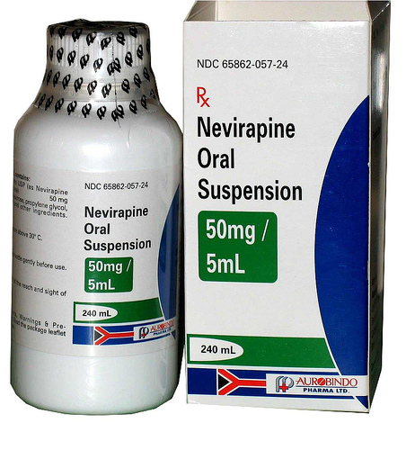
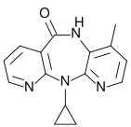
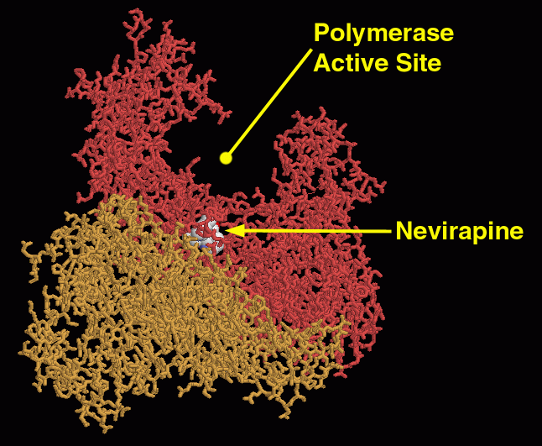

Slide 41
Delavirdine (DLV, Rescriptor) 400 mg tds;
SE: Rash
Is an inhibitor of CYP3A4
Not routinely used because of its complex dosing schedule

Slide 42
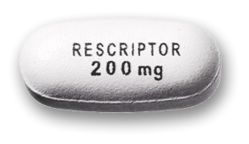
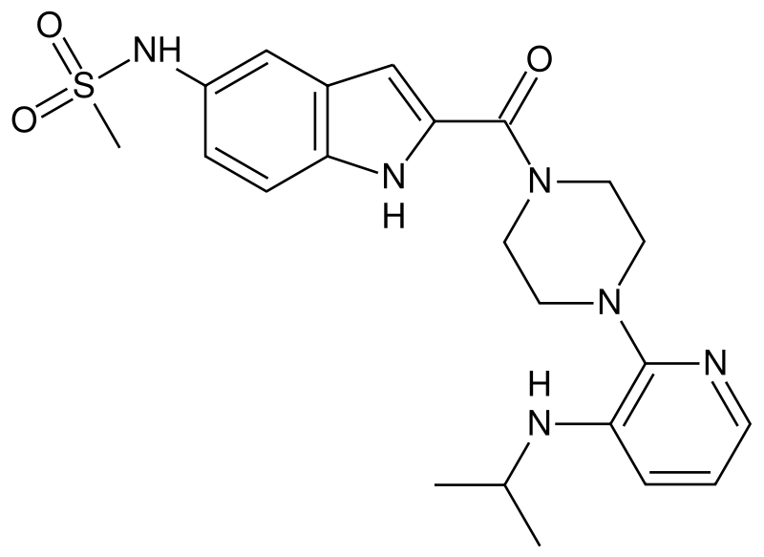

Delavirdine
(Rescriptor)

Slide 43
Efavirenz (EFV, Stocrin) 600 mg od;
SE: Rash, CNS or psychiatric side effects (vivid dreams, hullucinations, insomnia)
Has cross resistance with NVP
Side effects resolve over 4 weeks
Recommended on an empty stomach as fatty meals increase bioavailability

Slide 44
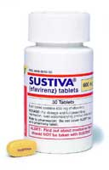
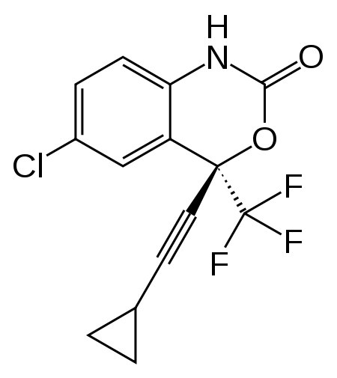
Efavirenz (Sustiva)

Slide 45
NNRTIs
Drug | Standard Dose | Dosage forms | Common AEs | Metabolism
Delavirdine (DLV) Rescriptor | 400 mg tid | 100mg tab, 200mg cap | Rash | Potent CYP3A inhibitor; 3A4 substrate
Nevirapine (NVP) Viramune | 200 mg qd x 14 d then 200 mg bid | 200mg tabs, Oral susp | Rash (SJ), hepatotoxicity | CYP3A inducer, auto inducer; 3A4, 2B6 substrate
Efavirenz* (EFV) Sustiva | 600 mg qhs | 50, 100, 200mg cap, 600mg tab | Vivid dreams, drowsiness or insomnia, rash (SJ), hyperlipidemia | CYP3A, 2B6 inducer; 2B6, 3A4 substrate

Slide 46
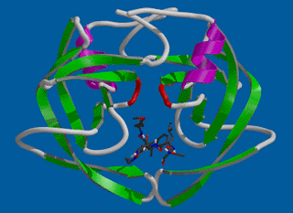

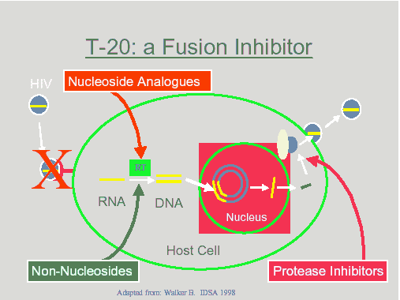
Protease Inhibitors (PIs): Mechanism of Action
Protease enzyme cleaves HIV precursor proteins (gag/pol polyproteins) into active proteins that are needed to assemble a new, mature HIV virus.
PIs bind to protease preventing the cleavage and inhibiting the assembly of new HIV viruses
HIV-1 Protease
PI
HIV
X

Slide 47
Are inhibitors of Protease enzyme
Hence prevent cleavage of HIV structural and enzymatic proteins of the virus
This prevents metamorphosis of the HIV virus into the mature infectious form
Have hepatic metabolism and are mostly inhibitors with Ritonavir being the most potent. Hence their concentrations may be reduced in the presence of other CYP inducers
Cause Lipid abnormalities; Nausea, vomiting and diarrhoea, but these resolve within 4 weeks
Are usually combined with low dose Ritonavir

Slide 48
Indinavir
Nelfinavir
Ritonavir
Saquinavir
Amprenavir
Fosmaprenavir
Lopinavir
Atazanavir
Darunavir
Tipranavir

Slide 49
Ritonavir 600 mg bd
Lopinavir 200 mg bd
Commonly, Lopinavir/ritonavir (LPV/r, Kaletra) 400/100 mg bd
Ritonavir is a very potent inhibitor of the isoenzyme 3A4, a subunit of the cytochrome P450 hepatic enzyme system.
Inhibition of these gastrointestinal and hepatic enzymes with small doses of Ritonavir allows boosting of the pharmacokinetic parameters of almost all PI’s.

Slide 50
Boosted PI pharmacokinetics
Drug concentration
Toxicity threshold
Boosted
PI
Efficacy threshold
PI
0
0
Time (hours)
Notes:
CYP3A4 is found in the liver and metabolizes protease inhibitors
Given in low does, 100mg, with the PI. Known as “boosting”

Slide 51
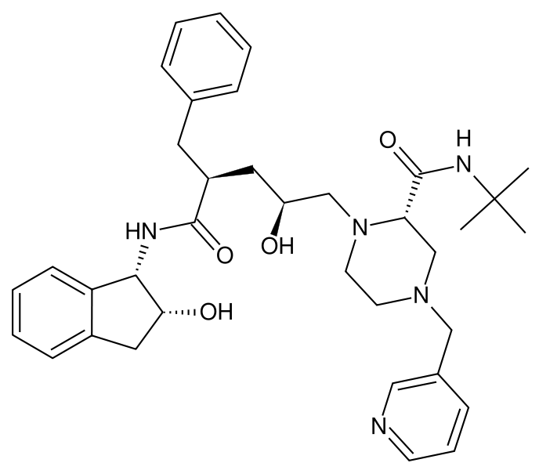
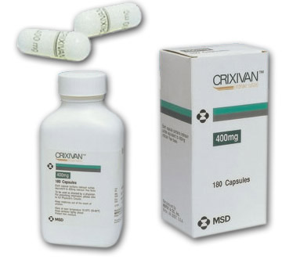
HIV Protease Inhibitors
Indinavir/Crixivan

Slide 52
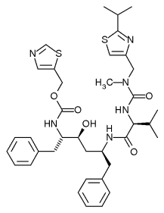
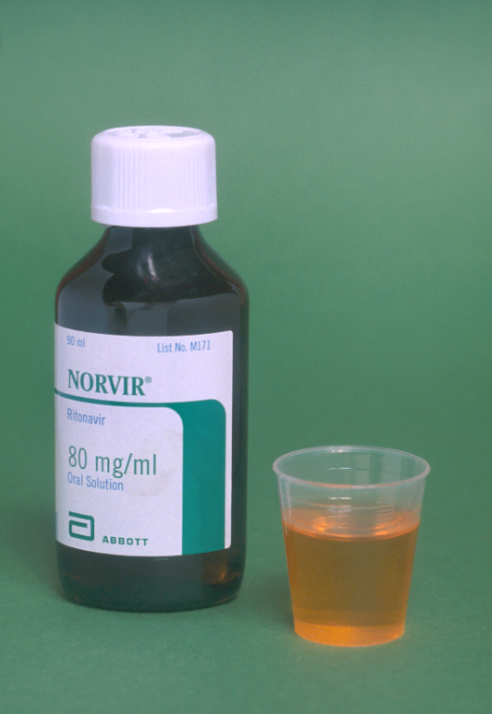
HIV Protease Inhibitors
Ritonavir/Norvir

Slide 53
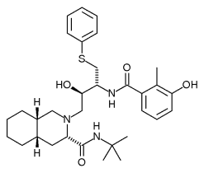
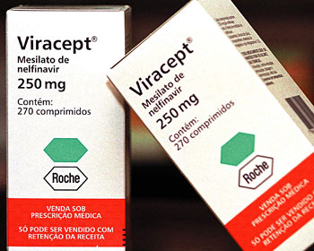

HIV Protease Inhibitors
Nelfinavir/Viracept

Slide 54
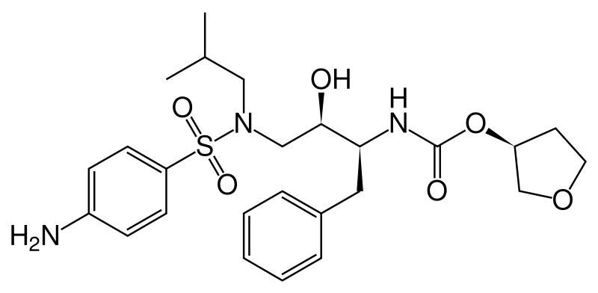
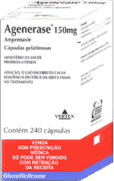
Amprenavir
(Agenerase)

Slide 55
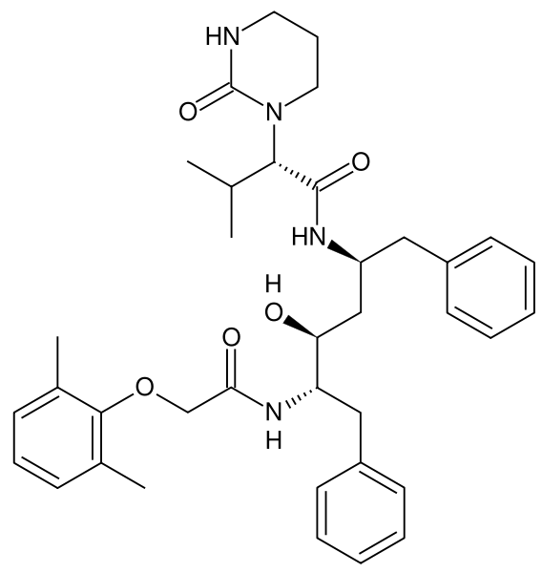
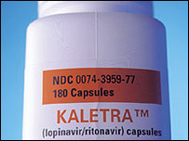


Lopinavir
Ritonavir

Slide 56


Tipranavir
Tipranavir, or tipranavir disodium, is a nonpeptidic protease inhibitor (PI) manufactured by Boehringer-Ingelheim under the trade names Aptivus®. It is administered with ritonavir in combination therapy to treat HIV infection and is given as two 250mg capsules together with 200mg of ritonavir twice daily.

Slide 57
Tipranvir
Tipranavir has the ability to inhibit the replication of viruses that are resistant to other protease inhibitors and it recommended for patients who are resistant to other treatments. Resistance to tipranavir itself seems to require multiple mutations.

Slide 58
Protease Inhibitors
 | Standard Dose | Dosage Forms | Metabolism | Common AEs**
Saquinavir (Invirase) (1) | 1000/ rtv 100 bid or 1600/ rtv 100 qd | 200mg caps, 500mg tabs | 3A, Pgp substrate; weak 3A inhibitor | GI intolerance
Nelfinavir (Viracept) (1) | 1250 bid, 750mg tid | 250mg, 625mg tabs, 50mg/g oral pwdr | 2C19 (M8→3A) substrate; weak 3A inhibitor | Diarrhea
Lopinavir/ ritonavir (Kaletra) (1,2) | 400/100 bid | 200/50 mg tabs, 80/20mg/5mL soln | 3A, Pgp substrate; 3A inhibitor; 2C9, 2C19 inducer | Dyspepsia, Nausea, vomiting, diarrhea, flatulence
Indinavir (Crixivan) (1-when taken with rtv) | 800/ rtv 100 bid, 800mg tid | 100, 200, 333, 400mg caps | 3A, Pgp substrate; weak 3A inhibitor | Nephrolithiasis ⇒ Drink 7-8 glasses of water per day; hyperbilirubinemia

Slide 59
Protease Inhibitors
 | Standard Dose | Dosage Forms | Metabolism | Common AEs**
Atazanavir (Reyataz) (1) | 400qd or 300/ rtv 100qd | 100, 150, 200mg caps | 3A substrate; 3A and UGT1A1 inhibitor | Hyperbilirubinemia, PR prolongation
Fosamprenavir (Lexiva) (1) | 1400mg bid; 700/100 RTV mg bid; 1400/200 RTV mg qd | 700mg tabs (Agenerase-APV liq available) | 3A4, Pgp substrate; 3A4 inducer/ Inhibitor | Rash, GI intolerance, caution with sulfur allergy
Tipranavir (Aptivus) (1,2) | 500/200 RTV mg bid | 250mg caps | 3A4, Pgp substrate; 3A4, inducer/ inhibitor??; Pgp inducer | Hepatotoxicity, Increased bleeding caution with sulfur allergy
Darunavir (Prezista) (1) | 600/100 RTV mg bid | 300mg tabs | 3A4 substrate; 3A4 inhibitors | Diarrhea, nausea, HA, nasopharyngitis
Ritonavir (Norvir) (1,2) | Used as a PK booster 100-200mg | 100mg caps; 80mg/mL | 2D6, 3A4, Pgp substrate; 3A4, Pgp inhibitor | Nausea, vomiting, diarrhea, GI upset

Slide 60
PIs
Lipids, Insulin Resistance (Lypodystrophy
Hypercolesterolemia
Usually hypertriglyceridemia, can have increased LDL and decreased HDL
Treat with Fibric acid derivatives and certain HMGCoA reductase inhibitors
Insulin Resistance
Treat with diet/exercise, metformin, TZDs, insulin, sulfonylureas
Notes:
PIs
Lipodystrophy (Buffalo hump, facial wasting)
Insulin resistance
Hyperlipidemia
IDV – Kidney stones
NFV - Diarrhoea

Slide 61



Lipodystrophy Illustrations
“Buffalo hump”
“Protease paunch”
“Facial wasting”

Slide 62
Integrase inhibitors
Raltegravir 400 mg bd
Block HIV integrase enzyme
Should only be used in combination with other agents as resistance develops quickly after virologic failure
SE: nausea, diarrhoea, headache
Elvitegravir

Slide 63


Raltegravir (Isentress)
Raltegravir is approved only for use only in individuals whose infection has proven resistant to other HAART drugs.
As with any HAART medication, raltegravir is unlikely to show durability if used as monotherapy.
Raltegravir is taken orally twice daily.

Slide 64


Slide 65


Slide 66
Dose Adjustments Between ARVs
Drug A | Drug B | Recommendation
Tenofovir | Didanosine | Dose ddI as 250mg QD with TDF 300mg QD
Tenofovir | Atazanavir | Use RTV 100mg QD with ATV + TDF
Efavirenz (Nevirapine) | Atazanavir | Use RTV 100mg QD with ATV + EFV
Efavirenz (Nevirapine) | Fosamprenavir | Use RTV with FPV
Efavirenz (Nevirapine) | Lopinavir/ritonavir | Increase LPV/RTV to 3 tabs BID
Notes:
Other ARVs, when given in combination should be dose adjusted.
Didanosine should be dose reduced when given with tenofovir as tenofovir increase didanosine concentrations.
Recall, efavirenz and nevirapine are potent P450 inducers; therefore, decrease concentrations of drug metabolized by P450.
When tenofovir, efavirenz, or nevirapine are given with atazanavir, ritonavir should be coadministered since these three ARVs reduce atazanavir concentrations.
When efavirenz or nevirapine are given with fosamprenavir, ritonavir should be coadministered and when efavirenz/nevirapine are given with lopinavir/ritonavir an extra tablet twice a daily should be given.

Slide 67
Important Drug Interactions
Do NOT use Simvastatin, Lovastatin, Antiarrthymics, Midazolam, Triazolam, Ergot derivatives, Rifamin, St. Johns Wort, or Garlic with most PIs or DLV
Do NOT combine Rifampin with PIs
LPV/RTV may be dose increased and combined with Rifampin
Conflicting data with EFV and NVP
Use other P450 inducers with CAUTION when combining with PIs and NNRTIs
Do NOT use Fluticasone or Alfuzosin with Ritonavir
Caution with Azoles, Clarithromycin, Oral Contraceptives, Phenytoin, Carbamazepine, Phenobarbital, Methadone, PDE5 inhibitors, Atorvastatin, Beta blockers, when combined with PIs
Avoid Herbal Products with Known or Suspected Interactions
When combining Protease Inhibitors, Often Dose Adjustments are Necessary
Notes:
There are several contraindications that should be emphasized.
Simvastatin and lovastatin should not be given with PIs due to the increase in concentrations of both these statins with PIs leading to increased risk of side effects.
Antiarrthymics, midazolam, triazolam, and ergot derivatives are also increased with PIs and delavirdine.
St. Johns Wort and garlic induce P450 so should not be used with any NNRTIs or PIs metabolized by P450s.
Rifampin is a potent P450 inducer and should not be given in general with PIs and caution should be used when given with efavirenz and nevirapine.
Fluticasone or an alpha blocker alfuzosin should not be given with ritonavir and if possible avoided with other PIs that are P450 inhibitors.
The other medications listed should be used with caution when combining with ARVs due to their inhibition effects (azoles, clairthromycin) or the fact that they are inducers of P450s or decrease concentrations of ARVs (OCs, phenytoin, carbamazepine, phenobarbital).
Also with drugs that are metabolized by P450s such as methadone, PDE5 inhibitors, atorvastatin, and SSRIs beta blockers caution when using ARVs that are P450 inhibitors should be monitored.
All herbal products should be avoided that have known, suspected, or unknown drug interactions due to the need for adequate ARV concentrations for optimal efficacy.
Finally, when combining PIs dosing should always be verified as dose adjustments are often necessary.

Slide 68
Specific Adverse Effects: NRTIs
Anemia
Zidovudine (ZDV)
Neuropathy
D4T, DDI, DDC
Pancreatitis
DDI, DDC
Hypersensitivity
Abacavir
Hypertriglyceridemia
Stavudine (D4T)
Lactic acidosis
Greater risk with ZDV, D4T, DDI

Slide 69
Adverse Effects: NNRTIs
All NNRTIs:
Rash
Drug-drug interactions
Nevirapine - hepatotoxicity, rash including Stevens-Johnson syndrome
Efavirenz - neuropsychiatric, teratogenic in primates
Notes:
Nevirapine: Symptomatic hepatic events (accompanied by rash in approximately 50% of cases) occur in significantly higher
frequency in female patients with pre-nevirapine CD4+ T lymphocyte count > 250 cells/mm3 or in male patients with
pre-nevirapine CD4+ T lymphocyte count > 400 cells/mm3.

Slide 70
Adverse Effects: PIs
Kidney stones
Indinavir; avoid with renal insufficiency
Diarrhea
Nelfinavir, ritonavir, lopinavir/ritonavir
Dyspepsia
SGC saquinavir, ritonavir, lopinavir/ritonavir, amprenavir
Rash
Amprenavir & fosamprenavir: sulfa-containing
Jaundice/indirect hyperbilirubinemia
Atazanavir, indinavir
Hyperlipidemia - All but atazanavir

Slide 71
Drug Interactions
ARV | Interacting Drug | Effects of ARV on drug (s)
Nevirapine (induces CYP3A4) | Ethinylestradiol | ↓ Levels. Alternative contraception
 | Rifampicin | ↓ Levels. Caution in TB therapy
 | Indinavir/ Nelfinavir | ↓ Levels of drugs. Need higher doses of Indinavir/Nelfinavir
 | Saquinavir | ↓ Levels. Avoid concurrent use
 | Ketoconazole | ↓ Levels . Coadmin. contraindicated

Slide 72
Drug Interactions
ARV | Interacting Drug | Effects of ARV on drug (s)
Efavirenz (EFZ) (induces CYP450) | Carbamezepine, phenobarb, phenytoin (induce CYP3A4) | ↓ Levels. Reduced efficacy. Drugs ↑ clearance of EFZ
 | Rifampicin | Levels unchanged
Zidovudine (AZT) | Stavudine | Decreased efficacy
Didanosine (ddI) | Ethambutol, isoniazid | ↑ Toxicity
Lamivudine (3TC) | Cotrimoxazole | ↑ 3TC levels. Not significant

Slide 73
Drug Interactions
ARV (All Pis inhibit CYP3A4) | Interacting Drug (s) | Effects of ARV on drug (s)
Lopinavir (soft gel contains alcohol) | Metronidazole | Disulfiram effect
Nelfinavir | Rifampicin (induces CYP3A4) | Incompatible.
Ritonavir, Nelfinavir, Indinavir, Lopinavir | Astemizole, Terfenadine, Cisapride | Cardiac arrythmias.
Ritonavir, Nelfinavir, Indinavir, Lopinavir | Sedative Hypnotics, antidepressants | Prolonged sedative & antidepressant effect

